Slide 1


ECEN 404
Creating STEM Contents: Solar Power with a Tracking System
Status Update #5
Leo Predanic
George Thuita
Brandon Cenci
Sponsor: Dr. Won Jang
TA: Souryendu Das

Slide 2

Executive Summary
Problem statement:
To create the future of tomorrow, we must invest today - by getting students interested in STEM early
Our Solution:
Excite K-12 students by creating a portable solar system for demonstration purposes
Contain digestible figures & animations to describe/track system

Slide 3
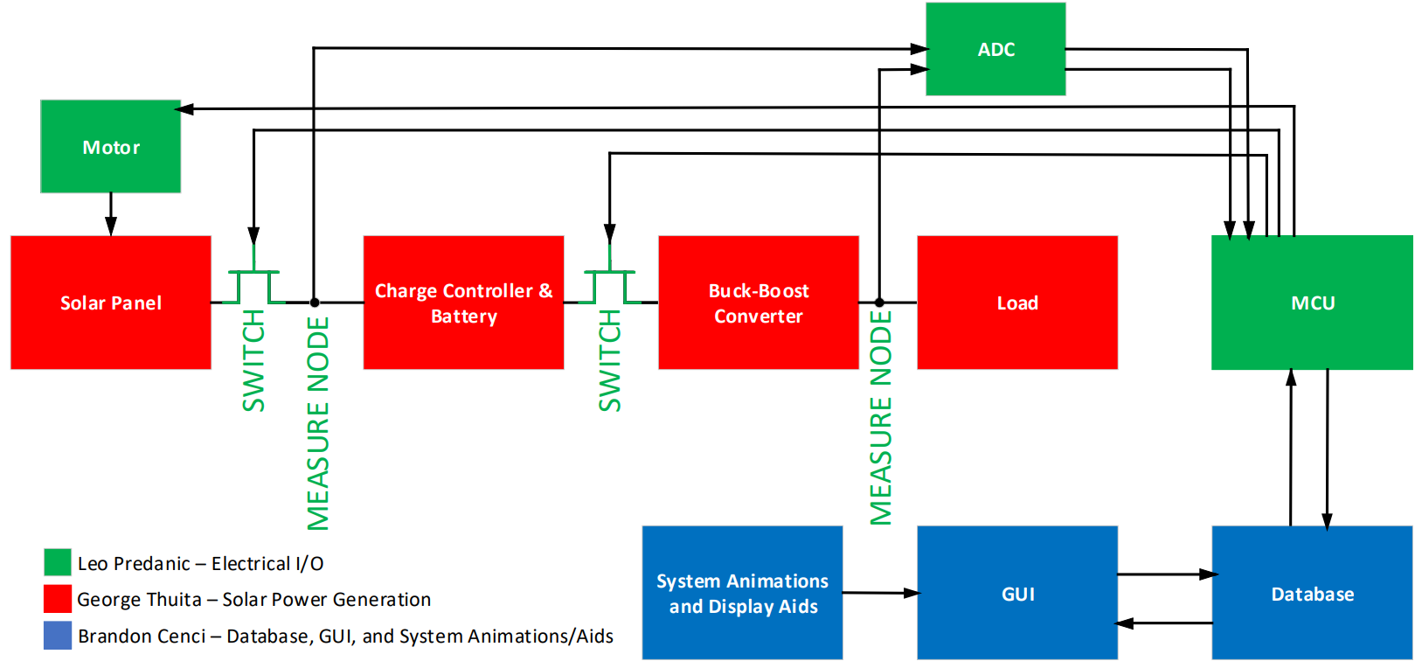
System Flow & Overview

Slide 4
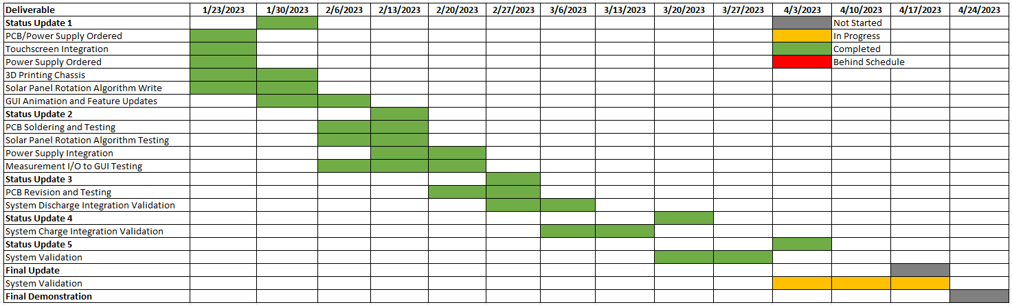
Execution

Slide 5
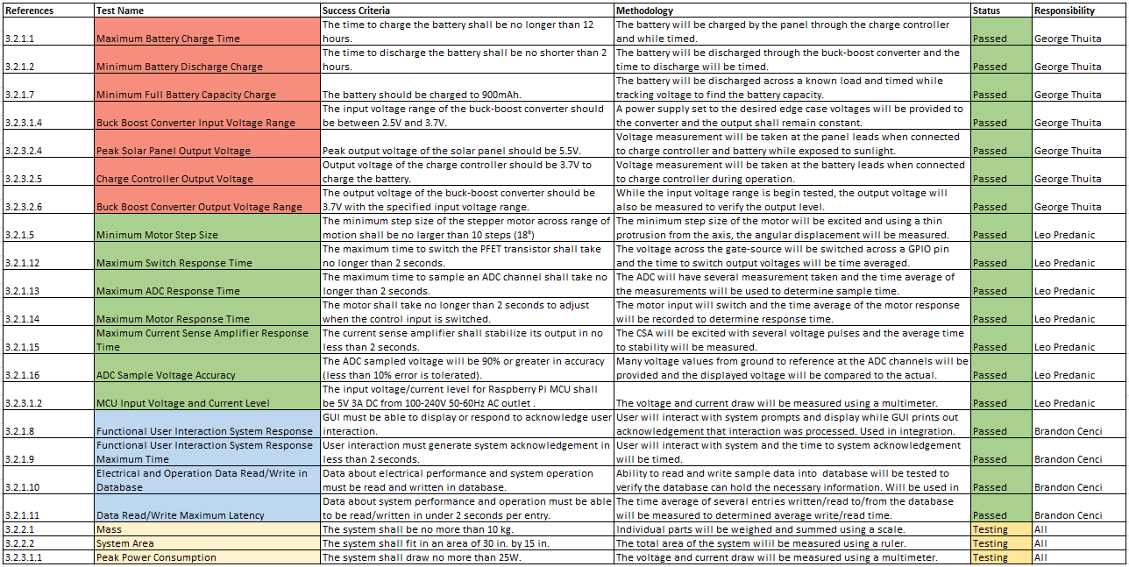
Validation

Slide 6
Integrated System George Thuita/Leo Predanic/Brandon Cenci
Accomplishments since last presentation 15 hrs each | Ongoing progress/problems and plans until next presentation
-Solved delay bug which stalled system response between motor and data collection -Adjusted motor stepping to improve delay, angle error tolerable from validation results -Preliminary complete system testing -GUI validation completed -Solar panel chassis redesign -GUI improvements | -Additional system testing -Minor GUI adjustments -Final system construction

Slide 7
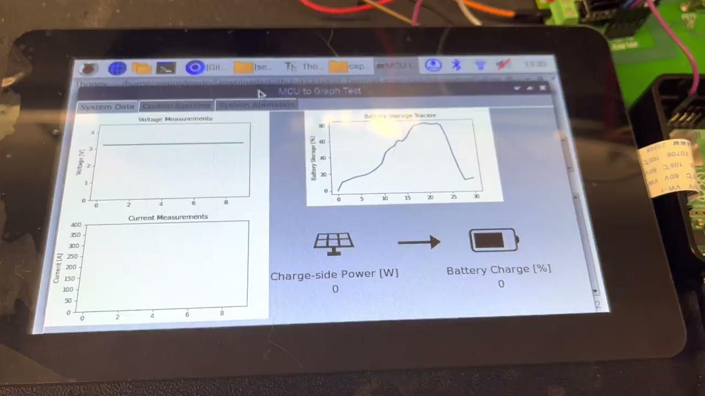
Integrated System (2) George Thuita/Leo Predanic/Brandon Cenci
GUI Voltage and Current Measurement (Solar Charging)

Slide 8
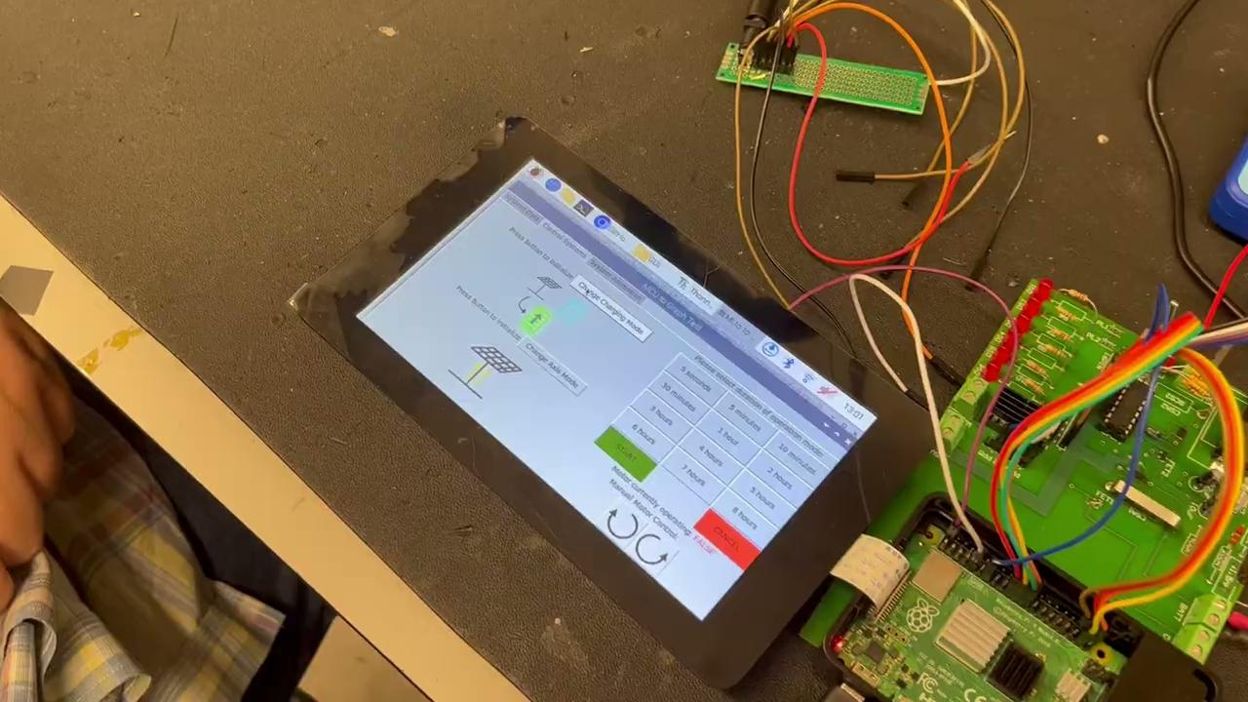
Integrated System (3) George Thuita/Leo Predanic/Brandon Cenci
GUI Voltage and Current Measurement (Load)

Slide 9
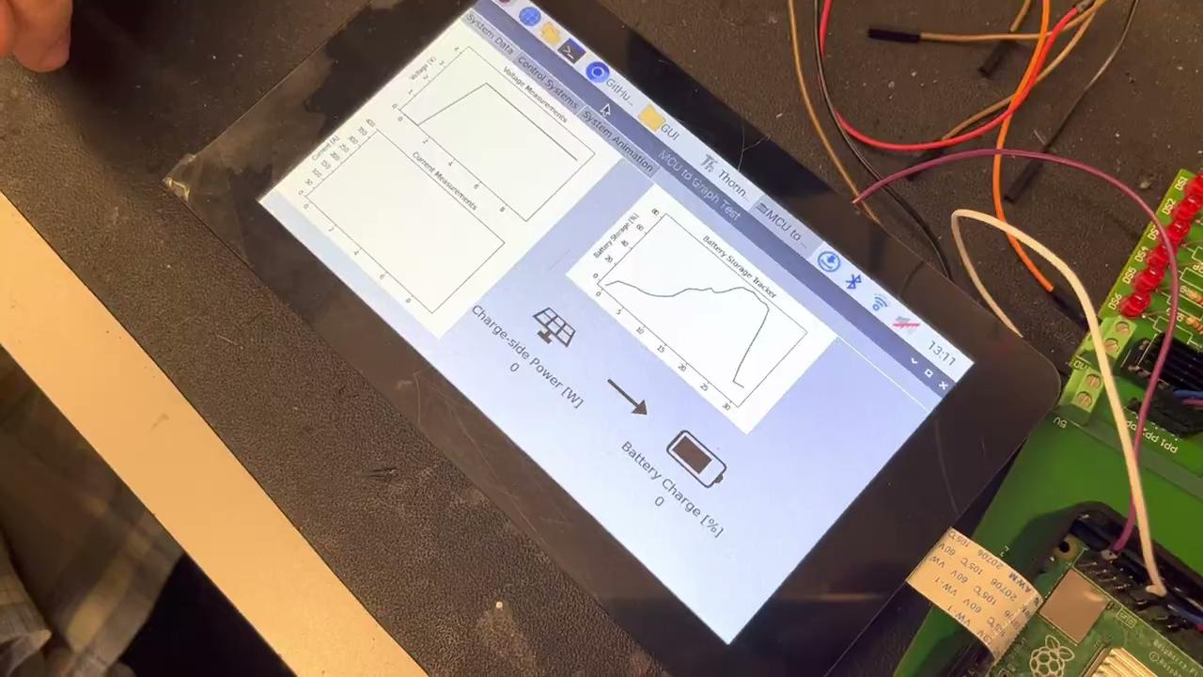
Integrated System (4) George Thuita/Leo Predanic/Brandon Cenci
Charge/Discharge Side FET Disconnection

Slide 10
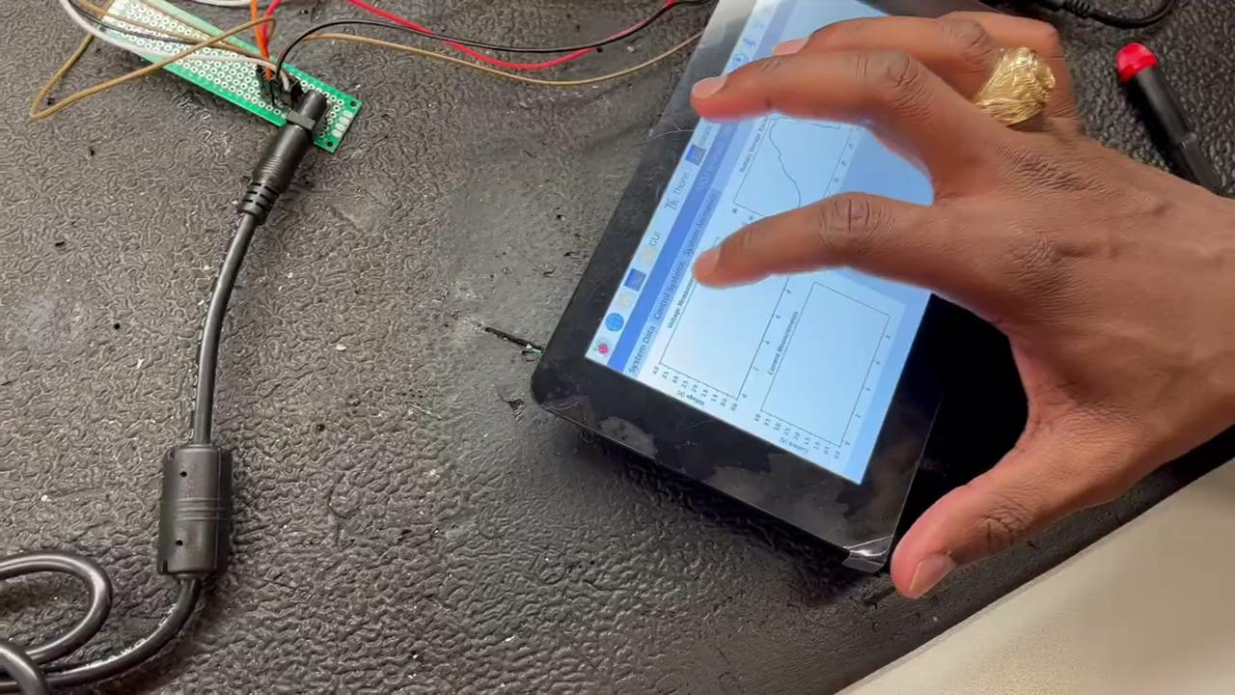
Integrated System (5) George Thuita/Leo Predanic/Brandon Cenci
GUI Motor Control

Slide 11
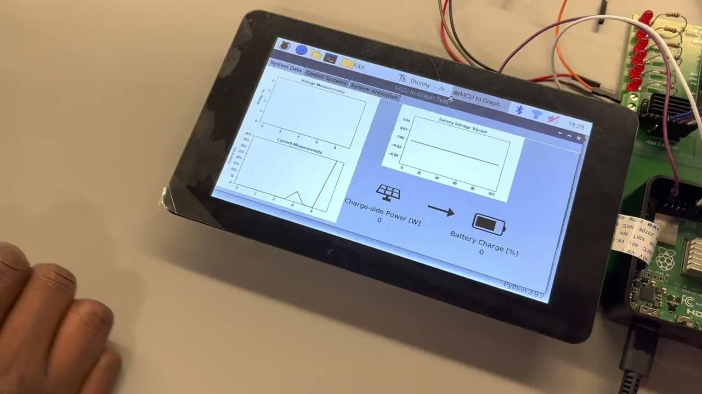
Integrated System (6) George Thuita/Leo Predanic/Brandon Cenci
GUI Charge and Discharge Animations

Slide 12
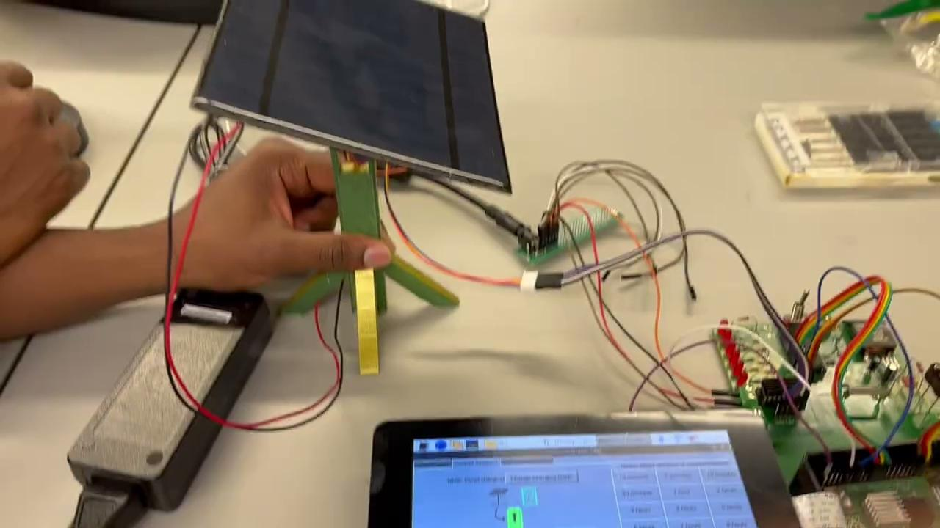
Integrated System (7) George Thuita/Leo Predanic/Brandon Cenci
Motor Control with Solar Panel Chassis

Slide 13
Thank You!
Questions?

